Slide 1


Giving life to your old hardware !
Self Hosting at Home

Slide 2

Today's
Agenda
1
What is selfhosting and why you should self host?
2
What can you selfhost and where?
3
Things to know while self hosting your applications.
4
Famous tools that you can self host at home.

Slide 3


$ whoami
Application Developer (Intern) @ Ather Energy
Maker.
Self proclaimed Jedi master :)
@adixthya

Slide 4
Are you ready?
Let's Start!

Slide 5
What is Self Hosting ?

Slide 6
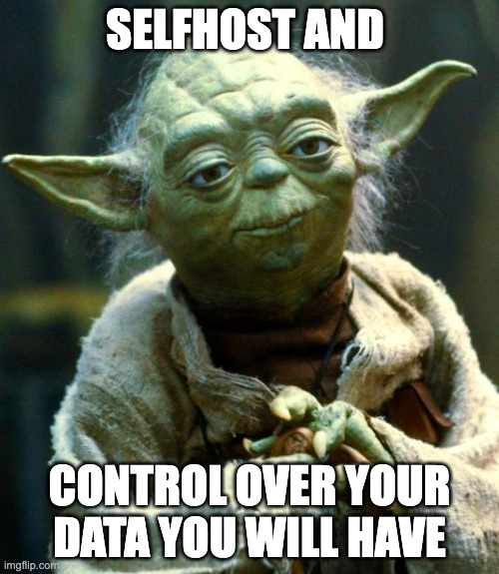
Why ?
1

Slide 7

Why ?
2

Slide 8
No vendor lock in.
3
Why ?
Cost Effective
4
Experience++
5

Slide 9
What can you self host?

Slide 10
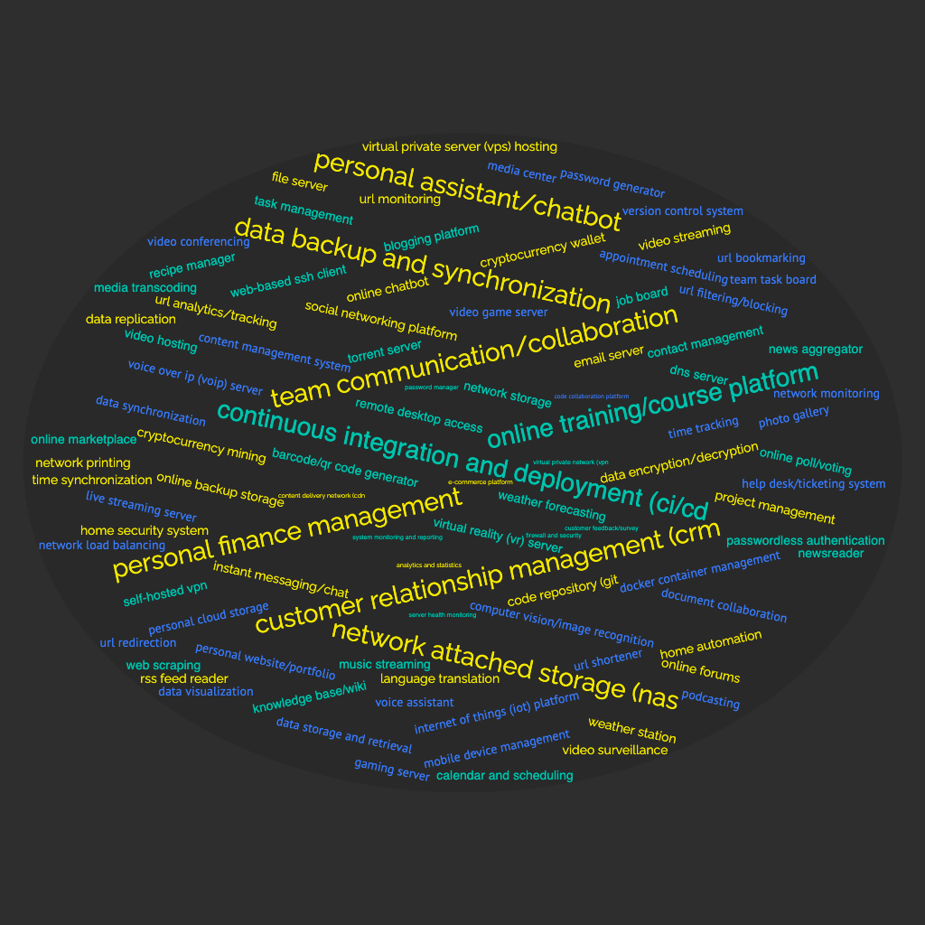

Anything!!!!
Anything!!!!

Slide 11
What i'm self hosting at home
1
NAS - Open Media Vault
5
Container Management - Portainer
Media Server - Jellyfin
6
VPN - Tailscale
2
3
Ad-blocker and DNS Server- PiHole
7
DashCam - DroidDashcam
4
Mailing List Manager - Listmonk
8
Auto Backup - SMB Sync 2

Slide 12
Where all can you host these?

Slide 13

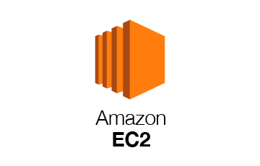
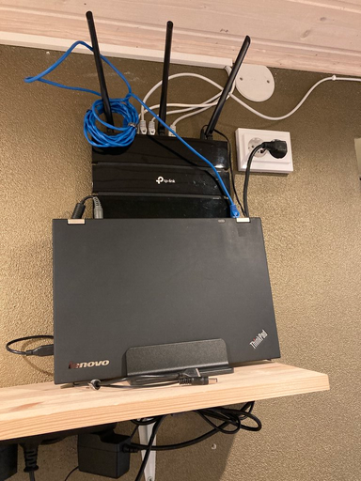





Your own hardware
Cloud
Old Laptop or Desktop
Raspberry Pi
Old Android Phone
Old Server
AWS EC2
GCP Compute Engine
Digital Ocean Droplet
Linode
Power Failure
Network Stability
Backup And Redundancy
Not Idiot Proof or Kid safe
Vendor Lock In
Data stored in another server
Security
Cost

Slide 14
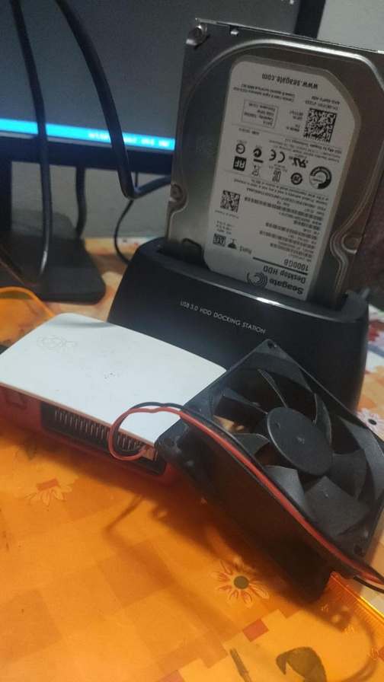






My Setup :
1
Raspberry Pi 3B (1.2 Ghz quad-core, 1Gb RAM)
1 TB Seagate Hard Drive, 3.5", 7200 RPM
2
3
10W PSU

Slide 15
Self Hosting at Home
101

Slide 16
1
Requirement
Steps :
2
Network
3
Configuration

Slide 17
Always read the hardware and software requirement of the application from the documentation before installation
A note to self, Ahemm

Slide 18
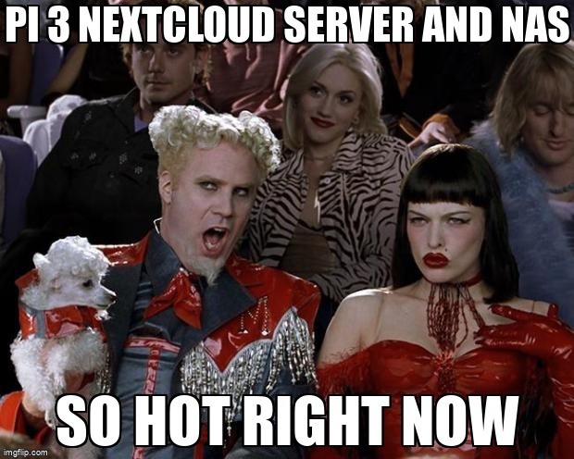
Ouch :/

Slide 19
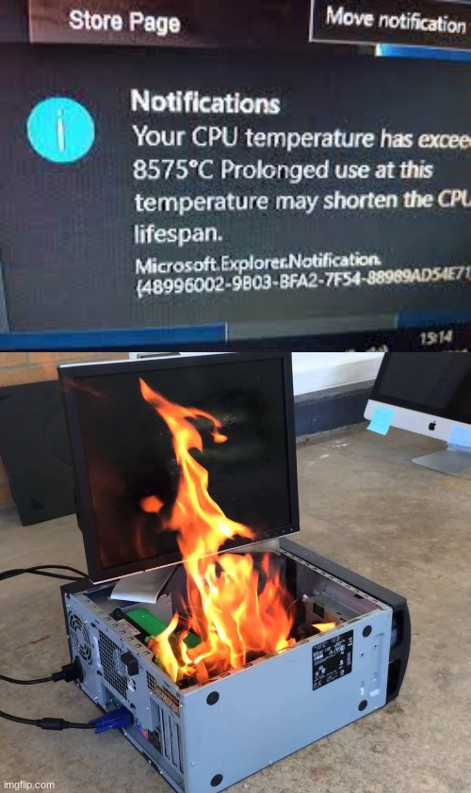
This definitely didn't happen

Slide 20
Chapter 2
Network

Slide 21
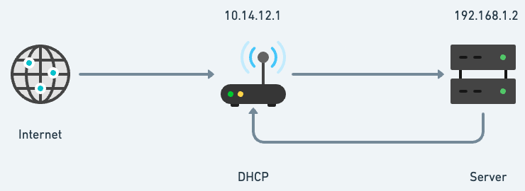
1
Enjoy your movie from another country
Setup Ngnix or Caddy
2
Port Forwarding
3

Slide 22
1
Enjoy your movie from another country
Setup Ngnix or Caddy
2
Port Forwarding
3

Slide 23
Problem 1
Dynamic IP

Slide 24



Solution :
Dynamic DNS
Notes:
Contact Akash to get a static IP

Slide 25
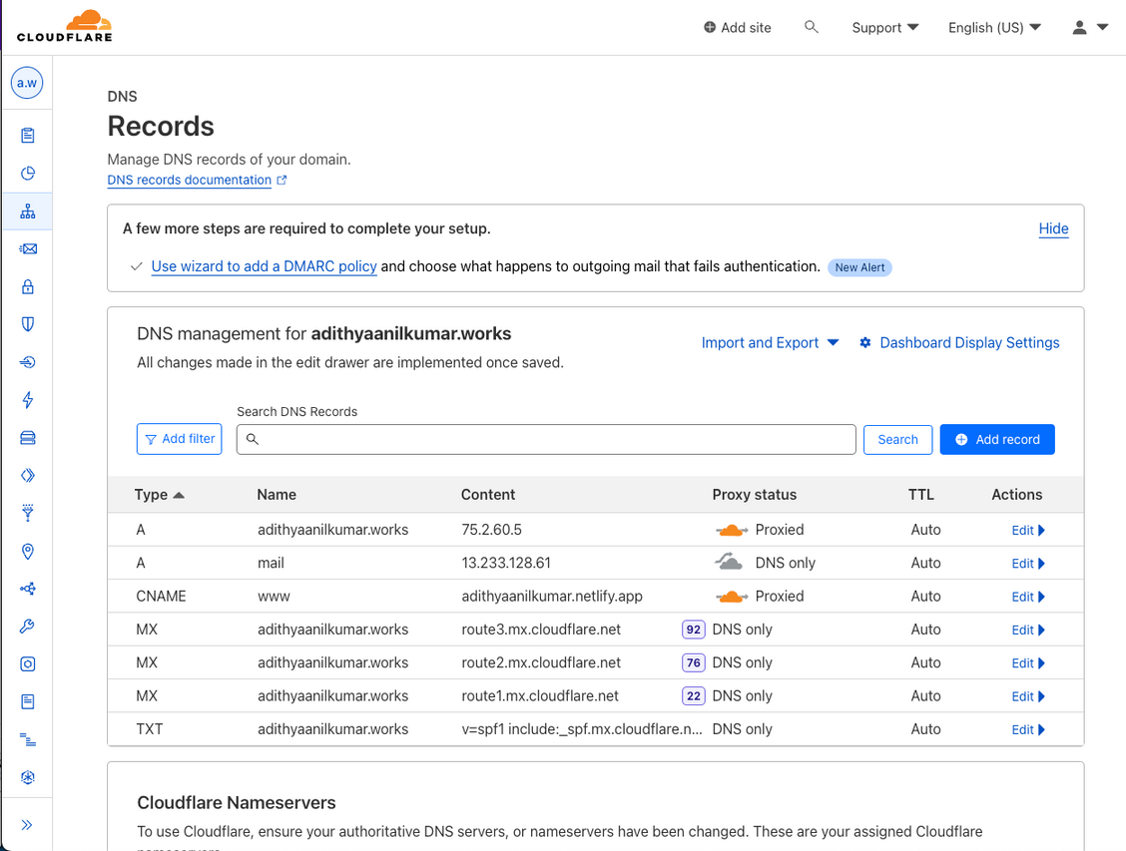
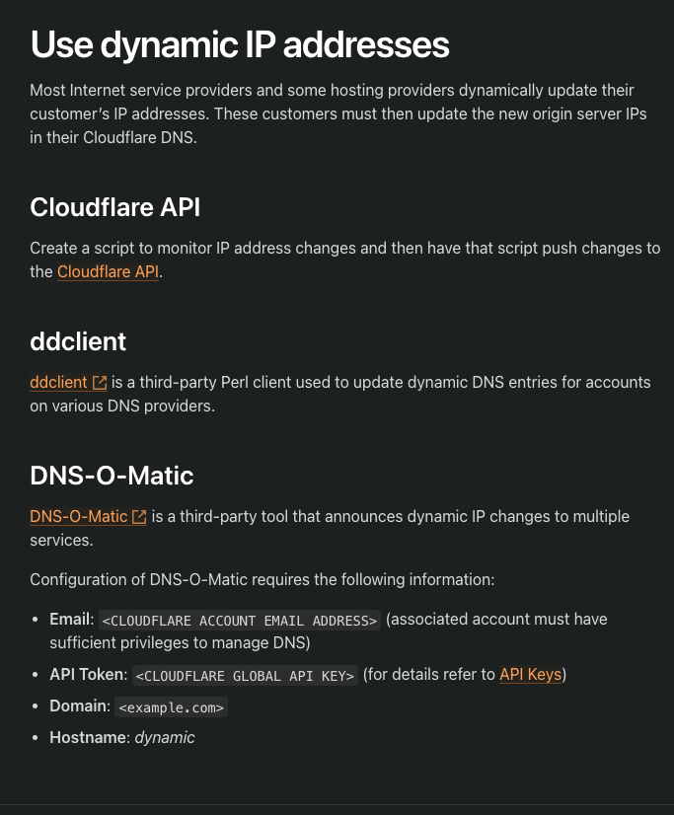

Slide 26
1
Enjoy your movie from another country
Setup Ngnix or Caddy
2
Port Forwarding
3

Slide 27
Problem 2
CG NAT

Slide 28
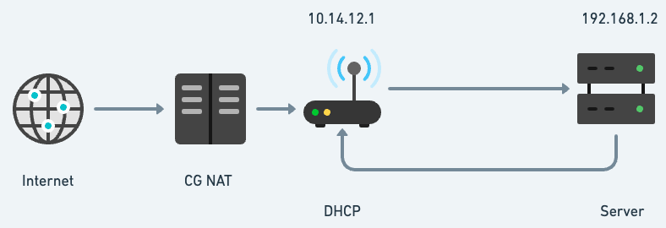
1
Enjoy your movie from another country
Setup Ngnix or Caddy
2
Port Forwarding
3
Notes:
talk about asianet being under CG NAT and portchecker.co

Slide 29




Solution :
Reverse SSH Tunnel
or
Reverse VPN Tunnel
Notes:
tell problems with ngrok, how a new link is generated every time the server is restarted
wireguard protocol and how difficult it is to setup manually

Slide 30
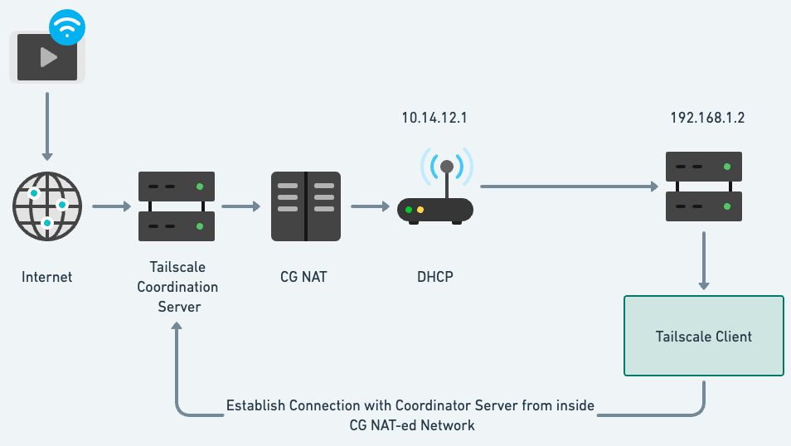

Slide 31
1
Enjoy your movie from another country
Setup Ngnix or Caddy
2
Port Forwarding
3

Slide 32
Easy setup
sudo apt-get install tailscale
1
2
sudo tailscale up
Notes:
TALK about exit node, mesh network, vpn from another country, scability
safety, only logged in users can use tailscale

Slide 33

OSS Alternative
https://headscale.net/

Slide 34
Are you ready?
Quizz Time

Slide 35



Slide 36


Slide 37
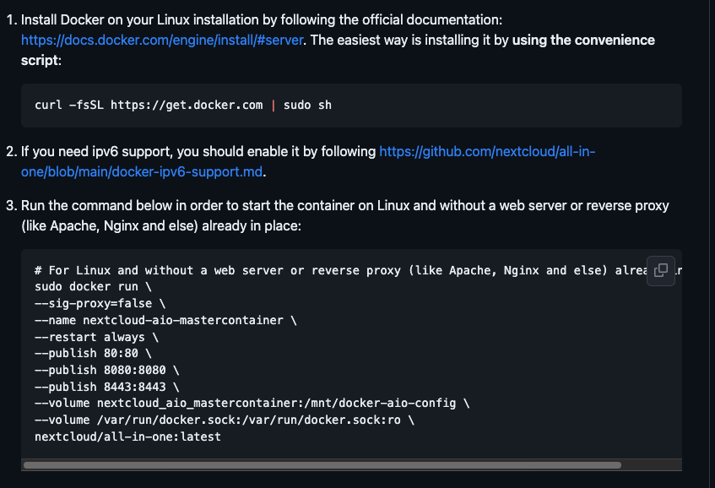
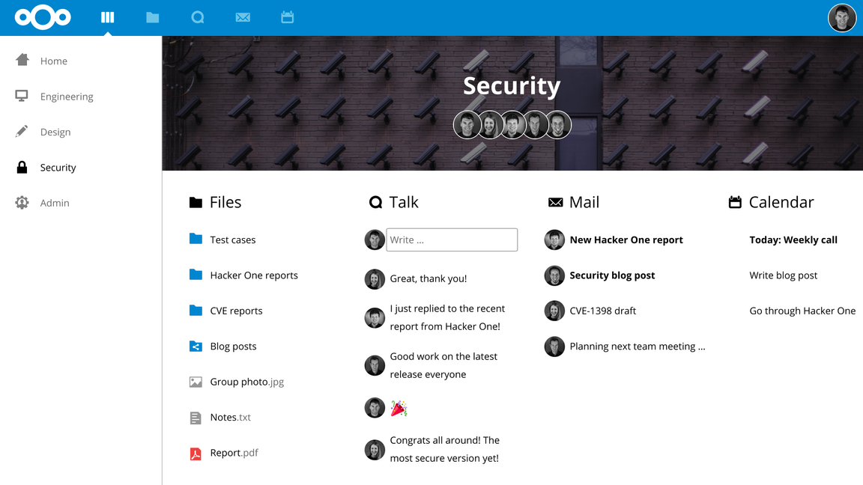

Slide 38


Slide 39

curl -s -S -L
https://raw.githubusercontent.com/AdguardTeam/AdGuardHome/master/scripts/install.sh |
sh -s -- -v
curl -sSL https://install.pi-hole.net | bash

Slide 40




Slide 41

curl https://repo.jellyfin.org/install-debuntu.sh | sudo bash

Slide 42


Slide 43

wget https://dl.photoprism.app/docker/docker-compose.yml

Slide 44


Slide 45

wget -O gitea https://dl.gitea.com/gitea/main-nightly/gitea-main-nightly-linux-amd64
chmod +x gitea

Slide 46


Slide 47


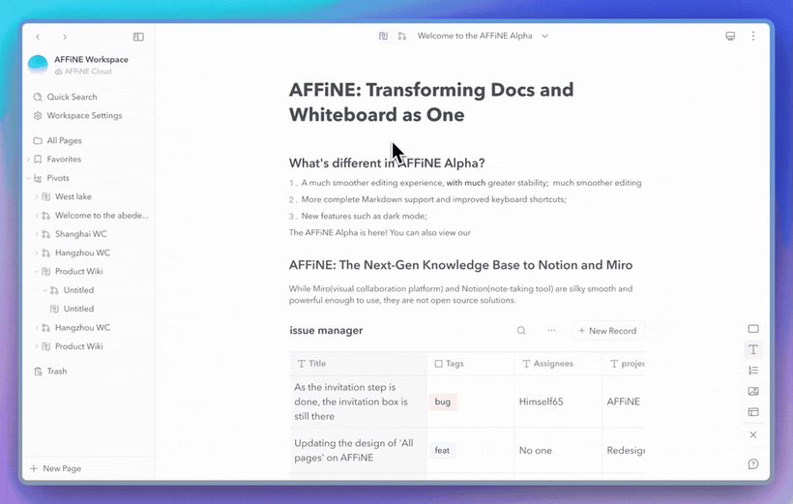
Affine - https://github.com/toeverything/AFFiNE

Slide 48
More tools at :
github.com/awesome-selfhosted

Slide 49
1
Self Hosting 101 - Mon School
Resources
Network Chuck - YouTube
2
3
github.com/mikeroyal/Self-Hosting-Guide

Slide 50
Bonus
For you

Slide 51

Have an old phone lying around ?

Slide 52



DashCam
Droid Dashcam or Open DashCam
Webcam
Android IP Camera
Virtual Keyboard and Mouse
KDE Connect

Slide 53
Thank you :)
Have a great day ahead.

